Slide 1
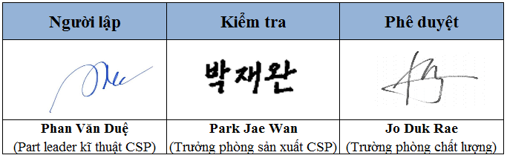
SFH881CA402 Analysis Report
Wisol Hanoi Co.,Ltd
Notes:
1

Slide 2
Contents
1
Team Member
2
Problem Description
3
Containment Action
4
Root Cause Analysis
5
Corrective Action
6
Verification of Correction Actions
7
Preventive Action
8
Approval
Notes:
2

Slide 3
1
Team Member
Origin information
Producing Area | Part | Code Number | Contact Person
WHC | SFH881CA402 | - | WHC QC Jo Deok rae
T/F TEAM
Team | Members | Details | Remark
制造 | Park Jae wan Principle Manager | Group Leader | -
制造 | Moon Hyung seok Manager | 驻在员
制造 | Phan van due | Part leader
品质 | Jo Deo krae Senior Manager | Group Leader
品质 | Nguyen Thi Mai Assistant Manager | Part leader
WTC 品质 | 金彪 科长 | CS 担当
Notes:
3

Slide 4
2
Problem Description
■ Received History
Item | Contents
Received Date | 2022.01.07
Site | vivo
P/N | B5 SFH881CA402
Defect Phenomenon | B5/BC0/GSM850 DRX校准失败
Defect Qty | 1 EA / 40 EA（新项目前期）
Factory | WHC
Marking / Reel No | Rmlo E / CNM073FFD00104
Received Qty. | 1ea
Notes:
4

Slide 5
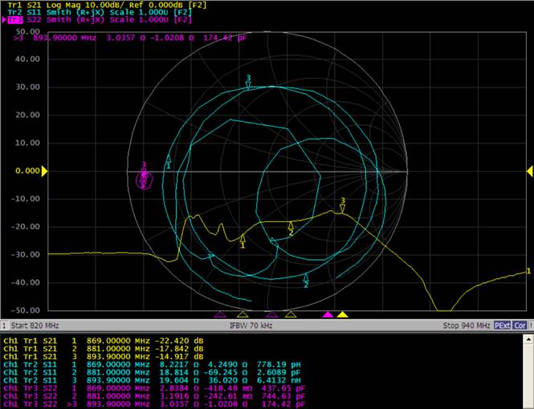
2
Problem Description
■ RF Measure
1) User Waveform _ vivo
SPL #1

Slide 6
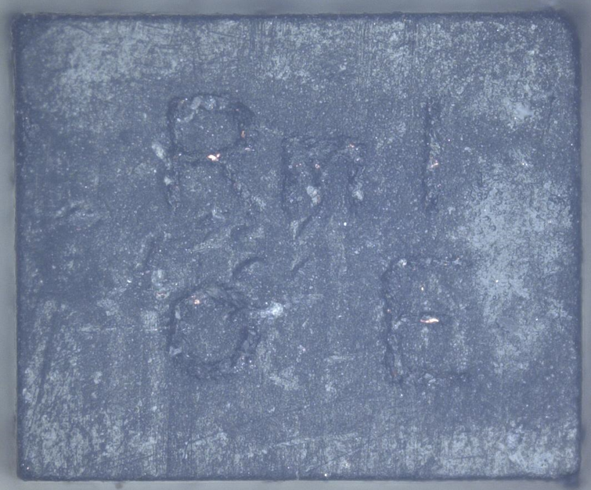
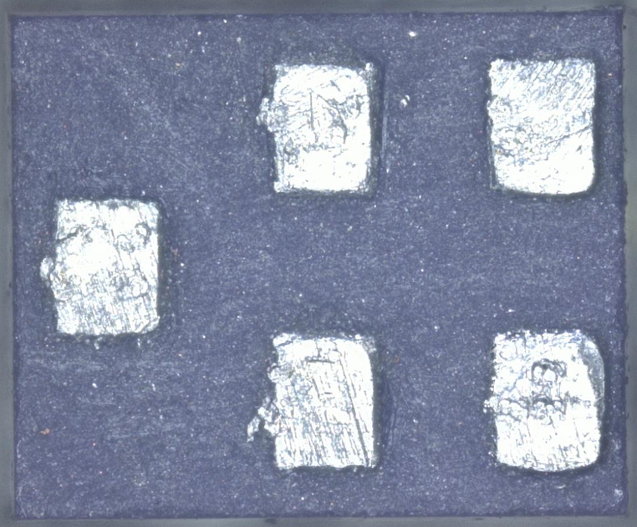
2
Problem Description
■ Visual Inspection
1) No Problem
 | SPL #1
Top
Bottom

Slide 7
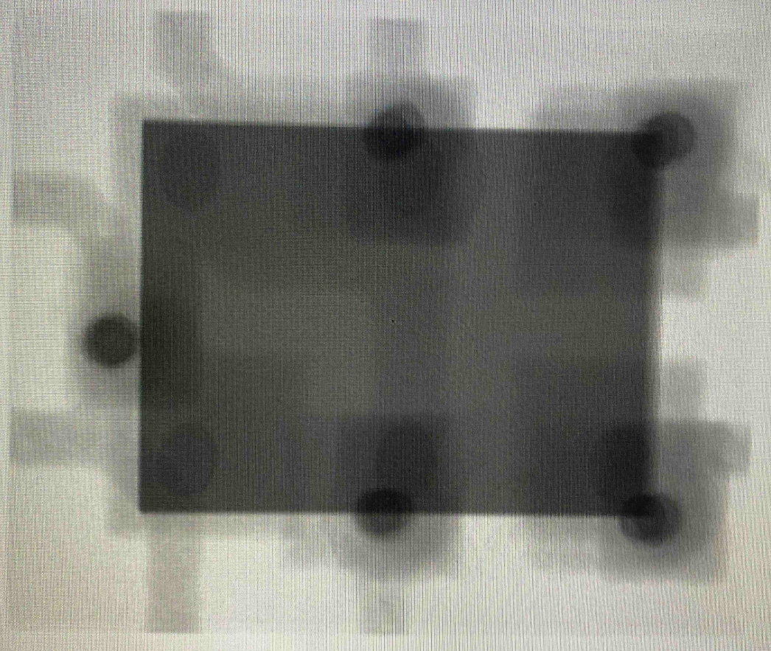
2
Problem Description
■ X-RAY:
1) No Problem
 | SPL #1
Top

Slide 8
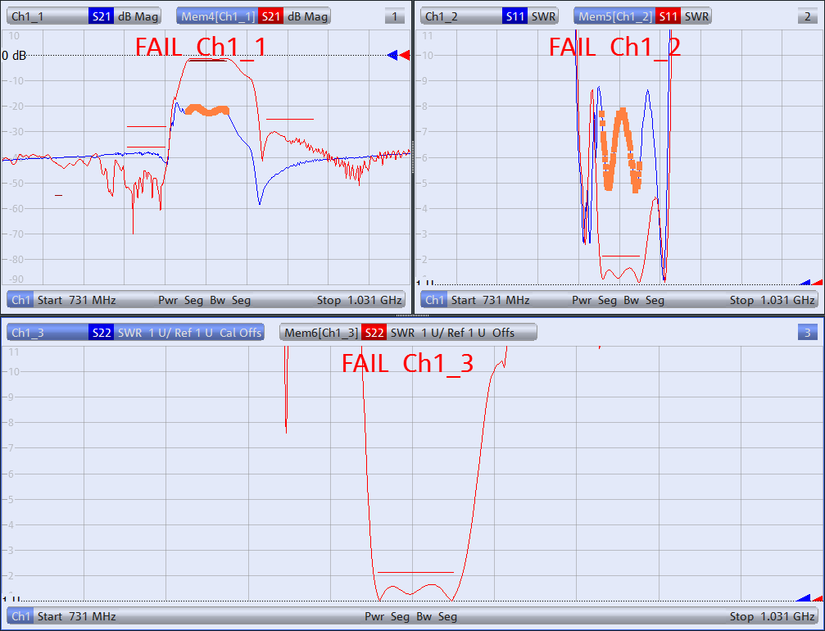
2
Problem Description
■ RF Measure
1) Waveform Fail
SPL #1

Slide 9
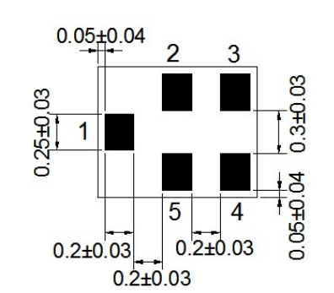
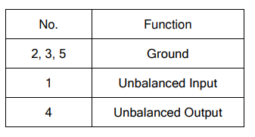
2
Problem Description
■ C Value 分析
1) Bottom Pin Map
2) C值 测量结果
Unit：pF
1511 | 1-2 | 4-5 | Result
Min | 2.5 | 3.6 | -
Max | 3.0 | 4.1 | -
#1 | 3.09 | 4.95 | Fail

Slide 10
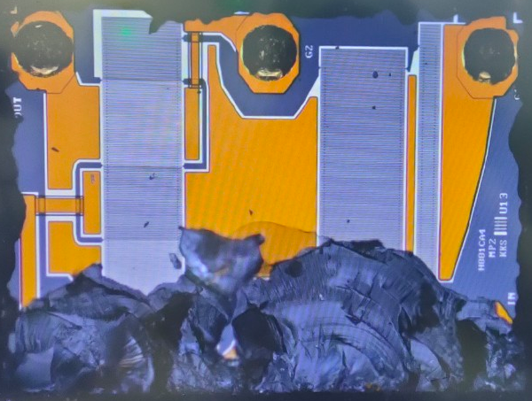
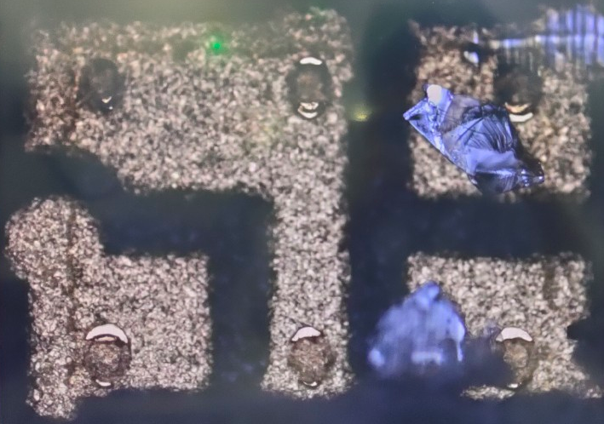
2
Problem Description
■ De-cap 分析
1) 分析失败（De-cap时，Chip破损）
- Bump 焊接状态良好
Chip
Ceramic PKG

Slide 11
2
Problem Description
■ Analysis Summary
No | Items | Result
1 | Phenomenon analysis | No Problem
2 | X-Ray | No Problem
3 | Frequency analysis | RF Fail
4 | C Value analysis | Fail
5 | Decap analysis | 分析失败
Notes:
11

Slide 12
3
Containment Action
■ Affect LOT: 按照Marking 基准 280K，其中vivo 210K
- 邀请临时隔离 210K，Lot List 如下；
- 另外 CNM073FFD00104（VOC Lot）残量 Reel 发送给天津Retest 及继续分析
Lot ID | Reel ID | Rework | Q'Ty | Marking No | Customer Name | Ship Reel | Remark
CNM073FFD00100 | CNM045FF800107 |  | 10,000 | RmIo E | UASCENT | RHFFP0000Z
 | CNM073FFD00101 |  | 10,000 |  | UASCENT | RHFFP0000X
 | CNM073FFD00102 |  | 10,000 |  | UASCENT | RHFFP0000W
 | CNM073FFD00103 |  | 10,000 |  | UASCENT | RHFFP0000V
 | CNM073FFD00104 |  | 10,000 |  | UASCENT | RHFFP00010
 | CNM073FFD00105 |  | 10,000 |  | UASCENT | RHFFP0000Y
 | CNM073FFD00106 |  | 10,000 |  | UASCENT | RHFFP0003D
CNM073FFD00200 | CNM045FFC00007 |  | 10,000 | RmIo E | SUNNY | RHFFT0003H
 | CNM073FFD00201 |  | 10,000 |  | SUNNY | RHFFT0003F
 | CNM073FFD00202 |  | 10,000 |  | SUNNY | RHFFT0003E
 | CNM073FFD00203 |  | 10,000 |  | SUNNY | RHFFT0003J
 | CNM073FFD00204 |  | 10,000 |  | SUNNY | RHFFT0003G
 | CNM073FFD00205 |  | 10,000 |  | SUNNY | RHFFT0003I
 | CNM073FFD00206 |  | 10,000 |  | SUNNY | RHFFT0002Y
CNM045FFE00000 | CNM045FFC00107 |  | 10,000 | RmIo E | UASCENT | RHFFP00014
 | CNM045FFE00001 |  | 10,000 |  | UASCENT | RHFFP00013
 | CNM045FFE00002 |  | 10,000 |  | UASCENT | RHFFP00015
 | CNM045FFE00003 |  | 10,000 |  | UASCENT | RHFFP00016
 | CNM045FFE00004 |  | 10,000 |  | UASCENT | RHFFP00011
 | CNM045FFE00005 |  | 10,000 |  | UASCENT | RHFFP00012
 | CNM045FFE00006 |  | 10,000 |  | UASCENT | RHFFP00039
CNM045FFE00100 | CNM073FFM00007 |  | 10,000 | RmIo E | UASCENT | RHFFQ000CE
 | CNM045FFE00101 |  | 10,000 |  | UASCENT | RHFFQ000CH
 | CNM045FFE00102 |  | 10,000 |  | UASCENT | RHFFQ000CG
 | CNM045FFE00103 |  | 10,000 |  | UASCENT | RHFFQ000CI
 | CNM045FFE00104 |  | 10,000 |  | UASCENT | RHFFQ000CD
 | CNM045FFE00105 |  | 10,000 |  | UASCENT | RHFFQ000CF
 | CNM045FFE00106 | CTM038FFQ00001 | 10,000 |  | UASCENT | RHFLA0008A | :COVER TAPE DEFECT: :包装盖带不良;

Slide 13
3
Containment Action
■ Affect LOT Yield, O/S Defect rate Status
Issue Lot
※ Keep Sample 분석 진행 시 VOC 불량 유형과 동일 유형 파형 없음

Slide 14
Thank you !

